Slide 1
Software Design and Analysis CS3004
Engr. Muhammad Umer Haroon

Slide 2
Lecture
Creational Patterns

Slide 3
Singleton Pattern

Slide 4
The Problem
What happens without Singleton

Slide 5
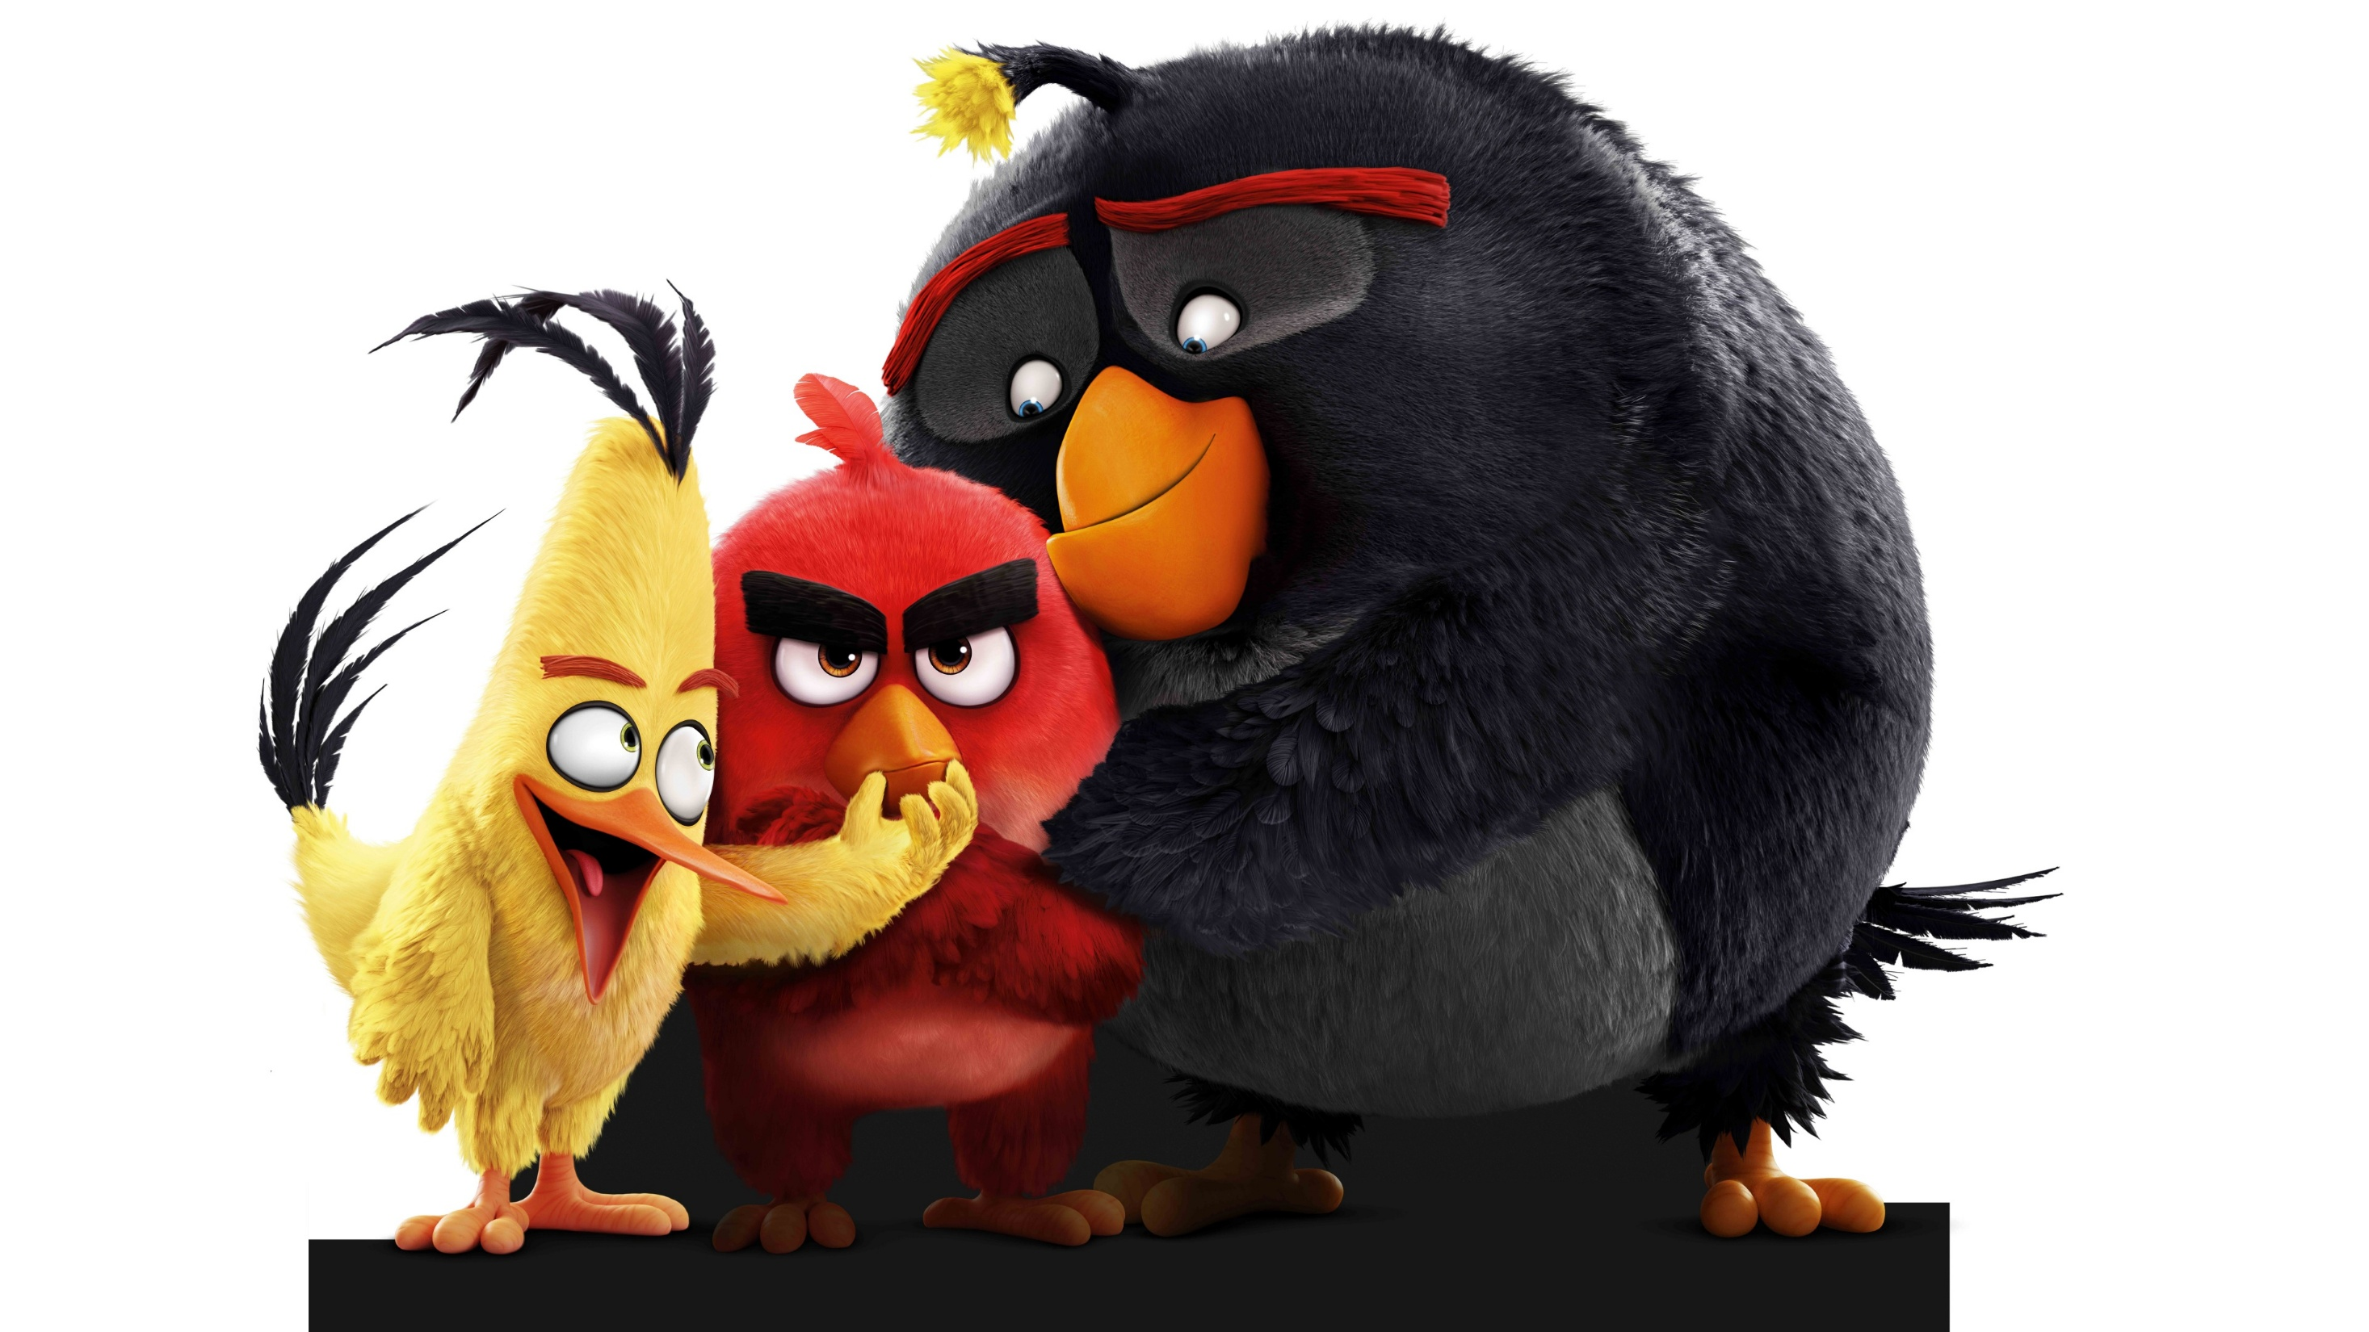

Slide 6
// Imagine two different parts of your game creating game state:
// Player scores 5000 points in Level 1
Game currentGame = new Game();
currentGame.addScore(5000);
// Meanwhile, another part of code accidentally creates NEW game
Game anotherGame = new Game(); // OH NO! Score = 0 again!
// Question: What's the player's score?
// Answer: Depends on which Game object you ask! TERRIBLE!

Slide 7
Why is this bad for Angry Birds?
ONE current score (5000 points)
ONE birds remaining (3 birds left)
ONE pigs remaining (2 pigs left)
ONE level number (Level 5)

Slide 8
If multiple Game objects exist
Score shows 5000 in one place
Score shows 0 in another place
Player gets confused and angry!

Slide 9
The Solution : Singleton
What is Singleton
"A pattern that ensures a class has ONLY ONE object and provides one way to access it"

Slide 10
The Angry Birds Singleton Implementation
/**
* GameManager - The ONE and ONLY game state for Angry Birds
* No matter where you access it, you get the SAME game
*/
public class GameManager {
// Step 1: Create a private static variable to hold the ONE instance
private static GameManager singleInstance = null;
// Step 2: Make constructor PRIVATE (no one else can create)
private GameManager() {
System.out.println("Angry Birds Game Started!");
System.out.println("Birds Ready!");
System.out.println("Pigs Located!");
}
// Step 3: Provide ONE global way to get the instance
public static GameManager getInstance() {
if(singleInstance == null) {
singleInstance = new GameManager();
}
return singleInstance;
}
// Game data (only ONE copy exists)
private int currentScore = 0;
private int birdsRemaining = 3;
private int pigsRemaining = 5;
private int currentLevel = 1;
// Game actions
public void addScore(int points) {
currentScore += points;
System.out.println("Score: " + currentScore);
}
public void useBird() {
birdsRemaining--;
System.out.println("Birds left: " + birdsRemaining);
if(birdsRemaining == 0 && pigsRemaining > 0) {
System.out.println("GAME OVER! No birds left!");
}
}
public void pigDestroyed() {
pigsRemaining--;
System.out.println("Pigs left: " + pigsRemaining);
if(pigsRemaining == 0) {
Notes:
private static GameManager singleInstance = null;
is part of the Singleton pattern implementation explained in the page you’re viewing. Here’s the breakdown based on that context:
Purpose: It declares a single, shared copy of the GameManager class. The idea is that Angry Birds (or any game) should only have one game state at a time—one score, one set of birds left, one set of pigs left. If multiple GameManager objects existed, the game state would become inconsistent (different scores in different places).
Keywords explained:
private: Only the class itself can directly access this variable. This prevents other classes from accidentally creating or modifying it.
static: The variable belongs to the class, not to any individual object. That means there’s only one copy of it across the entire program.
GameManager: The type of the variable—it will hold the one and only GameManager object.
singleInstance: The name chosen to emphasize that this is the single allowed instance.
= null: Initially, no game exists. The instance will be created later when needed.
How it works in the Singleton:
The constructor of GameManager is made private, so no one can call new GameManager() directly.
The getInstance() method checks if singleInstance is null. If it is, it creates the object once. If not, it returns the already existing object.
This ensures that every part of the program always refers to the same GameManager.
Why it matters in Angry Birds (from the page): Without this, you could end up with two different GameManager objects—one showing score 5000, another showing score 0. That would confuse the player and break the game. The Singleton guarantees consistency: one scoreboard, one set of birds, one set of pigs, one level tracker.

Slide 11
Complete Game Demo: Singleton in Angry Birds
public class AngryBirdsGame {
public static void main(String[] args) {
System.out.println("===== ANGRY BIRDS =====");
System.out.println("Press 1 to play!\n");
// Get the ONE game manager
GameManager game = GameManager.getInstance();
// Play Level 1
System.out.println("--- Level " + game.getCurrentLevel() + " ---");
game.addScore(1000); // Hit first pig
game.pigDestroyed();
game.useBird(); // Used one bird
game.addScore(2000); // Hit second pig
game.pigDestroyed();
game.useBird(); // Used second bird
game.addScore(3000); // Hit third pig
game.pigDestroyed();
// Check if level complete
System.out.println("\n--- Level " + game.getCurrentLevel() + " ---");
game.addScore(5000);
game.pigDestroyed();
// Try to create another game (WON'T WORK!)
System.out.println("\n--- Trying to cheat by creating new game ---");
GameManager anotherGame = GameManager.getInstance();
// Check if it's the same game
System.out.println("Same game object? " + (game == anotherGame));
System.out.println("Score from first reference: " + game.getScore());
System.out.println("Score from second reference: " + anotherGame.getScore());
System.out.println(" Both show the SAME score! Singleton works!");
}
}

Slide 12
Probable output
===== ANGRY BIRDS =====
Press 1 to play!
Angry Birds Game Started!
Birds Ready!
Pigs Located!
--- Level 1 ---
Score: 1000
Pigs left: 4
Birds left: 2
Score: 3000
Pigs left: 3
Birds left: 1
Score: 6000
Pigs left: 2
--- Level 2 ---
Score: 11000
Pigs left: 4
--- Trying to cheat by creating new game ---
Same game object? true
Score from first reference: 11000
Score from second reference: 11000
Both show the SAME score! Singleton works!

Slide 13
Why Singleton for Angry Birds
Why can't we just use static variables?

Slide 14
Answer: Singleton gives you an OBJECT with full control!
// Static approach (BAD)
class BadGame {
static int score;
static int birds;
}
// Problems:
// 1. Can't reset for new game easily
// 2. Can't have multiple save slots
// 3. Can't implement interfaces
// 4. Hard to test

Slide 15
When does the game start?
// Lazy initialization (we used this)
getInstance() { // Game starts ONLY when player presses "Play"
if(instance == null) instance = new GameManager();
}
//vs Eager initialization
private static GameManager instance = new GameManager(); // Game starts at app launch

Slide 16
For Angry Birds: Lazy is better! Player might just browse menu.

Slide 17
Complete code example
// Bird class that uses Singleton GameManager
class RedBird {
private String name = "Red";
public void launch() {
System.out.println("\n" + name + " bird launched!");
GameManager game = GameManager.getInstance();
game.useBird();
}
public void hitPig() {
System.out.println(name + " hit a pig!");
GameManager game = GameManager.getInstance();
game.addScore(1000);
game.pigDestroyed();
}
}
class YellowBird {
private String name = "Yellow (Speed)";
public void launch() {
System.out.println("\n" + name + " bird launched! SUPER FAST!");
GameManager game = GameManager.getInstance();
game.useBird();
}
public void hitPig() {
System.out.println(name + " smashed through 2 pigs!");
GameManager game = GameManager.getInstance();
game.addScore(2500);
game.pigDestroyed();
game.pigDestroyed(); // Hits two pigs
}
}
class Pig {
private String size;
public Pig(String size) {
this.size = size;
}
public void getHit() {
System.out.println(size + " pig says: OINK! (damaged)");
GameManager game = GameManager.getInstance();
game.addScore(500);
game.pigDestroyed();
}
}
// Play the game
public class PlayAngryBirds {
public static void main(String[] args) {
GameManager game = GameManager.getInstance();
RedBird red = new RedBird();
YellowBird yellow = new YellowBird();
Pig smallPig = new Pig("small");
// Level 1
System.out.println("\n=== LEVEL 1 START ===");
red.launch();
smallPig.getHit();
yellow.launch();
yellow.hitPig();
System.out.println("\n=== GAME SUMMARY ===");
System.out.println("Final Score: " + game.getScore());
System.out.println("Level reached: " + game.getCurrentLevel

Slide 18
Is Singleton good for every class in Angry Birds? NO! Only for classes that must have ONE instance.

Slide 19
Aspect | Singleton (singleInstance) | Static Variable
Encapsulation | The GameManager object is hidden behind getInstance(). You can control when and how it’s created. | Static variables are exposed directly; no control over initialization logic.
Flexibility | You can later extend GameManager with interfaces, inheritance, or polymorphism. It behaves like a normal object. | Static variables are rigid—no inheritance, no polymorphism, no interfaces.
Lifecycle control | You decide when the instance is created (lazy initialization, eager initialization, etc.). | Static variables are created when the class is loaded, whether you need them or not.
Testability | You can mock or replace the singleton instance in unit tests. | Static variables are hard to mock or replace, making testing brittle.
Consistency | Guarantees one consistent object across the program. | Also one copy, but without the ability to enforce rules or add behavior.
Future-proofing | If later you want multiple managers (e.g., multiplayer mode), you can refactor the singleton into a factory. | Static variables don’t scale—you’d have to rewrite everything.

Slide 21
Factory Pattern - Creating Different Birds

Slide 22
The Angry Birds Problem
// Without Factory - HARDCODED creation
class Level1 {
void createBirds() {
RedBird bird1 = new RedBird();
YellowBird bird2 = new YellowBird();
BlackBird bird3 = new BlackBird();
BlueBird bird4 = new BlueBird();
// What if we need 100 birds? What if bird types change?
}
}
// Problem: Every level needs to know EVERY bird type!
// If we add a new bird (White Bird), EVERY level must change!

Slide 23
Issues with hardcoding:
Level 1: Creates Red, Yellow, Black
Level 2: Creates Red, Yellow, Black (duplicate code!)
Level 3: Creates Red, Yellow, Black (again!)
Add new bird → change 100+ levels
Change bird behavior → change everywhere!

Slide 24
مسئلہ حَل کرنا
A pattern that creates objects without specifying the exact class.
And this is factory pattern

Slide 25
he Angry Birds Factory Implementation
/**
* BirdFactory - Creates different birds based on type
* No need to know how each bird is created!
*/
// Step 1: Create a common interface for all birds
interface Bird {
void launch();
void ability();
void hitPig();
}
// Step 2: Create different bird types
class RedBird implements Bird {
private String name = "Red";
@Override
public void launch() {
System.out.println(name + " bird launched! (Normal shot)");
}
@Override
public void ability() {
System.out.println("Ability: No special ability - straightforward");
}
@Override
public void hitPig() {
System.out.println(name + " hit pig! +1000 points");
}
}
class YellowBird implements Bird {
private String name = "Yellow";
@Override
public void launch() {
System.out.println(name + " bird launched! (SPEED BOOST!)");
}
@Override
public void ability() {
System.out.println("Ability: Tap screen for speed boost through blocks");
}
@Override
public void hitPig() {
System.out.println(name + " smashed through multiple pigs! +2500 points");
}
}
class BlackBird implements Bird {
private String name = "Black";
@Override
public void launch() {
System.out.println(name + " bird launched! (EXPLOSIVE!)");
}
@Override
public void ability() {
System.out.println("Ability: Tap to EXPLODE and destroy everything!");
}
@Override
public void hitPig() {
System.out.println(name + " EXPLODED! All pigs nearby destroyed

Slide 26
Levels using Factory
class Level1 {
private BirdFactory factory;
public Level1() {
this.factory = new BirdFactory();
}
public void play() {
System.out.println("\n===== LEVEL 1: EASY =====");
// Factory creates birds - Level doesn't know HOW
Bird bird1 = BirdFactory.createBird("red");
Bird bird2 = BirdFactory.createBird("yellow");
Bird bird3 = BirdFactory.createBird("red");
bird1.launch();
bird1.ability();
bird1.hitPig();
bird2.launch();
bird2.ability();
bird2.hitPig();
bird3.launch();
bird3.hitPig();
}
}
class Level5 {
public void play() {
System.out.println("\n===== LEVEL 5: HARD =====");
// Hard levels get powerful birds
Bird[] birds = {
BirdFactory.createBird("black"),
BirdFactory.createBird("yellow"),
BirdFactory.createBird("blue"),
BirdFactory.createBird("black")
};
for(Bird bird : birds) {
bird.launch();
bird.ability();
bird.hitPig();
System.out.println("---");
}
}
}
class SpecialLevel {
public void play() {
System.out.println("\n===== BONUS LEVEL =====");
// Factory can create birds dynamically based on score
GameManager game = GameManager.getInstance();
int score = game.getScore();
Bird specialBird;
if(score > 10000) {
specialBird = BirdFactory.createBird("black"); // Powerful
} else {
specialBird = BirdFactory.createBird("red"); // Basic
}
specialBird.launch();
specialBird.ability();
}
}

Slide 27
Complete demo code
public class AngryBirdsWithFactory {
public static void main(String[] args) {
// Initialize game
GameManager game = GameManager.getInstance();
// Play different levels
Level1 level1 = new Level1();
level1.play();
Level5 level5 = new Level5();
level5.play();
SpecialLevel bonus = new SpecialLevel();
bonus.play();
// What if we need a new bird type?
System.out.println("\n===== NEW BIRD ADDED! =====");
System.out.println("Adding White Bird (Egg Layer)");
// Just add to Factory - no other code changes!
// (In real code, just add to switch statement)
}
}

Slide 28
Why not just use new RedBird() everywhere
// Without Factory
Level1: new RedBird(), new YellowBird(), new RedBird()
Level2: new RedBird(), new YellowBird(), new BlackBird()
Level3: new RedBird(), new BlueBird(), new YellowBird()
// 50 levels = 150 places to change if bird changes!
// With Factory
Level1: BirdFactory.createBird("red")
Level2: BirdFactory.createBird("red")
Level3: BirdFactory.createBird("red")
// 1 place to change (the Factory) if bird changes!
Factory centralizes creation - change ONE place, not 100 places!

Slide 29
What if we add a new bird?
// Step 1: Create new bird class
class WhiteBird implements Bird {
// Implement all methods
}
// Step 2: Add to Factory (ONE change!)
case "white": return new WhiteBird();
// All 50 levels automatically get the new bird! No other changes!

Slide 30
When factory is not useful
// If you only have ONE type of bird
Bird simple = new RedBird(); // Factory is overkill
// If birds are very simple to create
// Factory adds unnecessary complexity
Use Factory when you have MULTIPLE types or COMPLEX creation logic.

Slide 31
Advanced Factory - Parameterized Birds
// Factory that creates birds with DIFFERENT properties
class AdvancedBirdFactory {
public static Bird createBird(String type, int powerLevel) {
Bird bird = createBird(type);
// Apply power level
for(int i = 0; i < powerLevel; i++) {
bird = upgradeBird(bird);
}
return bird;
}
private static Bird upgradeBird(Bird bird) {
System.out.println(" Bird upgraded!");
return bird; // Would wrap with power-up decorator
}
}
// Usage
Bird superBird = AdvancedBirdFactory.createBird("red", 3);

Slide 32
In Angry Birds, when is Factory pattern useful? Answer: When creating different bird types, different pig types, different block types
What's easier: Changing 100 level files OR changing 1 Factory file? Answer: 1 Factory file! That's why we use Factory pattern.
Can Factory create pigs too? Answer: YES! Create PigFactory for small, medium, large pigs!

Slide 33
Both patterns together
public class CompleteAngryBirds {
public static void main(String[] args) {
// Singleton: ONE game state
GameManager game = GameManager.getInstance();
// Factory: Create birds easily
Bird bird1 = BirdFactory.createBird("red");
Bird bird2 = BirdFactory.createBird("yellow");
Bird bird3 = BirdFactory.createBird("black");
// Play the game
bird1.launch();
bird1.hitPig();
bird2.launch();
bird2.hitPig();
bird3.launch();
bird3.hitPig();
// Check final state (Singleton)
System.out.println("Final Score: " + game.getScore());
}
}

